Slide 1



GUI APPLICATION
USING PYTHON TKINTER
CS PROJECT

Slide 2

STUDENT MANAGEMENT SYSTEM
(PYTHON GUI APPLICATION)

Slide 3



INTRODUCTION
"STUDENT MANAGEMENT SYSTEM (SMS) IS A SOLUTION TOOL THAT IS DESIGNED TO TRACK, MAINTAIN AND MANAGE ALL THE DATA GENERATED BY A SCHOOL, INCLUDING THE GRADES OF A STUDENT, THEIR ATTENDANCE, THEIR INTERPERSONAL ACTIVITIES RECORDS, ETC.,"

Slide 4

OBJECTIVES
❏ Handling the data
❏Single storage
❏ Fetching reports
❏ Ease of communication
❏Reduce workload
❏Searching the data

Slide 5
FLAWS IN CURRENT SYSTEM
❏Maintenance of the records is difficult.
❏Manual process.
❏Chance of occurrence of errors.
❏Involves large amount of paper work.
❏Time consuming process.
❏Slow Updating and Renewal of Data.
❏Not Secure

Slide 6

PROPOSED SYSTEM
❏Reliable & Accurate
❏Non redundant information
❏Fast & Efficient processing
❏Centralized database
❏User Friendly Interface
❏Search facility
❏More Secure
❏GUI Interface

Slide 7
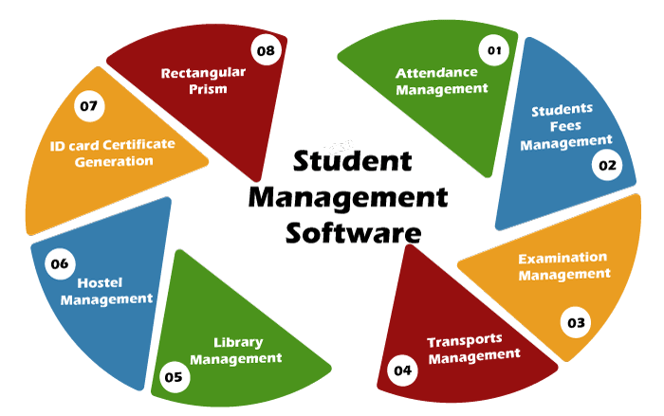
BENEFITS OF USING STUDENT MANAGEMENT SYSTEM

Slide 8
1. ENHANCES THE OVERALL PERFORMANCE OF STUDENTS
2. IT HELPS TO STREAMLINE ALL TASK
3. IMPROVED COMMUNICATION
4. WELL-ORGANIZED MANAGEMENT AND ORGANIZATION OF PROGRAMS
5. HELPS TO MAINTAIN THE RECORD OF ALL STUDENTS
6. REDUCTION OF HUMAN LABOUR, PAPERS, AND WORKLOAD
BENEFITS OF
USING STUDENT MANAGEMENT
SYSTEM

Slide 9
MODERN PILLARS OF STUDENT MANAGEMENT SYSTEM
1. CLOUD-BASED
2. INFORMATION SECURITY
3. INTEGRATIONS

Slide 10
HARDWARE REQUIREMENTS
I. PROCESSOR : Intel Core i5-6100U CPU @ 3 GHz
II. RAM : 8.00GB
III. SYSTEM TYPE : 64 bit operating system,x64 based processor
SOFTWARE REQUIREMENTS
I. Operating system : Windows 11
II. Language/Technologies Used : Python, Tkinter, tktcalender,datetime
III. IDE : VS Code
IV. Python version : 3.10.0
V. Database : MySQL , MS Excel
MySQL 8.0 Command Line Client

Slide 11


Slide 12
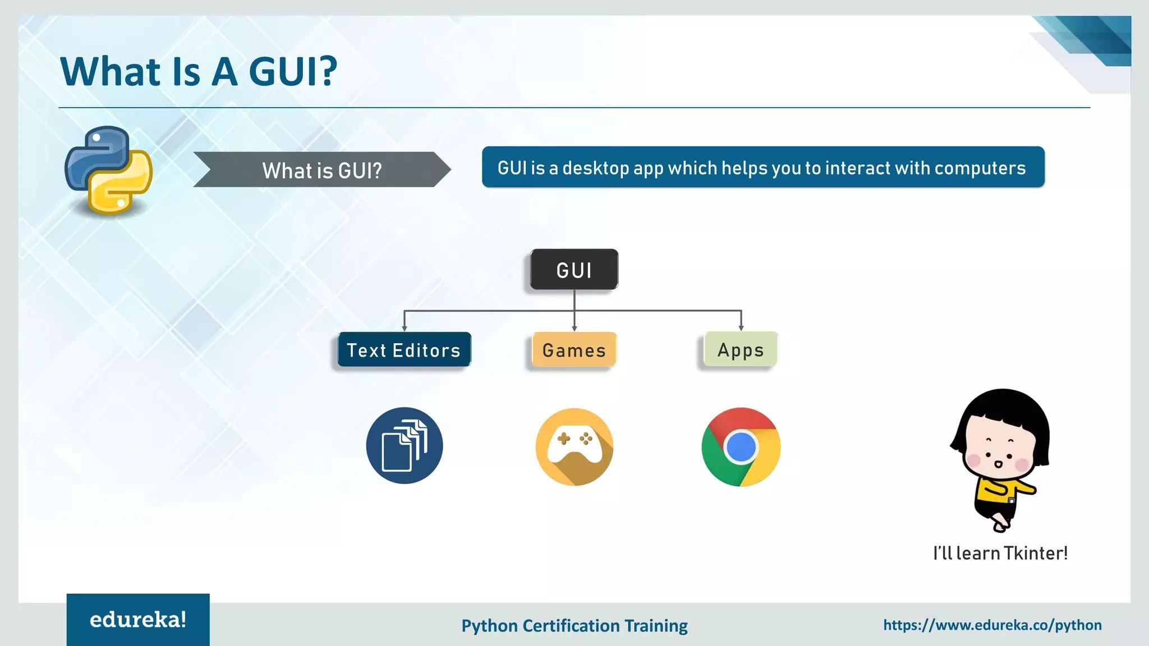

Slide 13
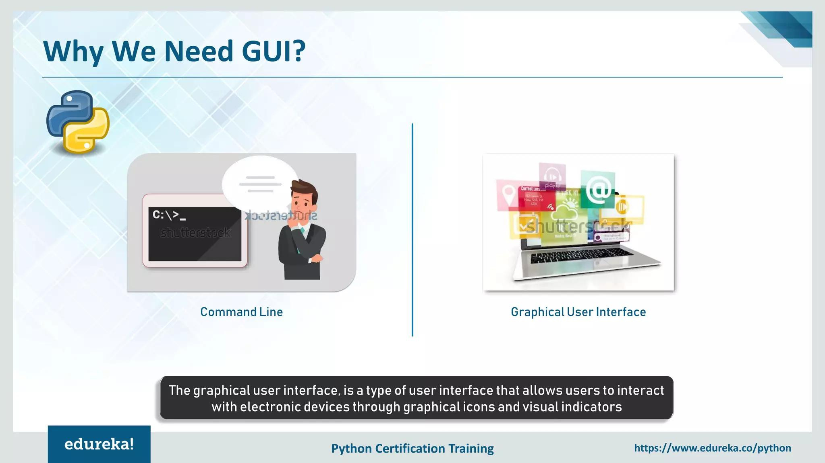

Slide 14

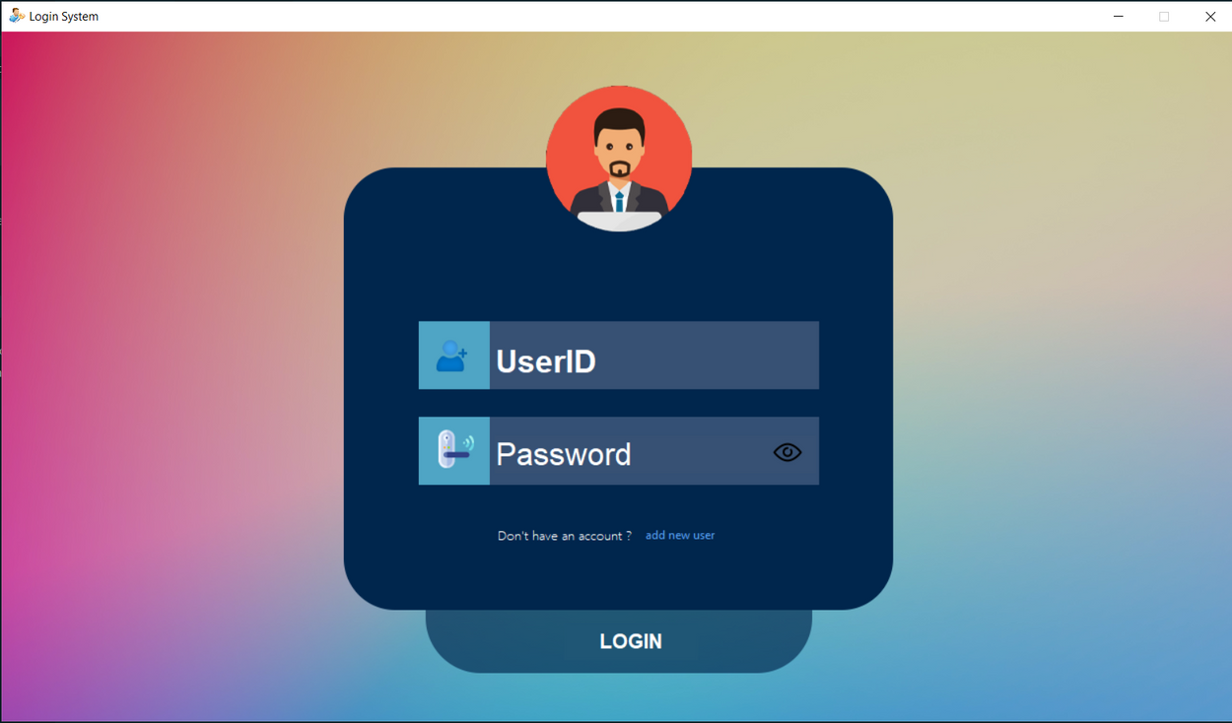
GUI PROGRAMMING IN
PYTHON
LOGIN WINDOW

Slide 15
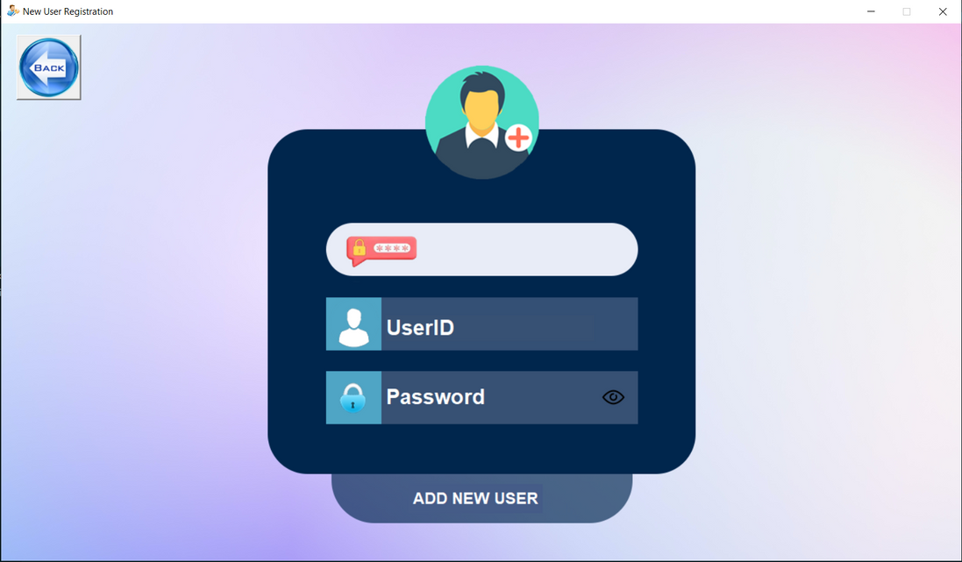
GUI PROGRAMMING IN
PYTHON
SIGN UP WINDOW

Slide 16
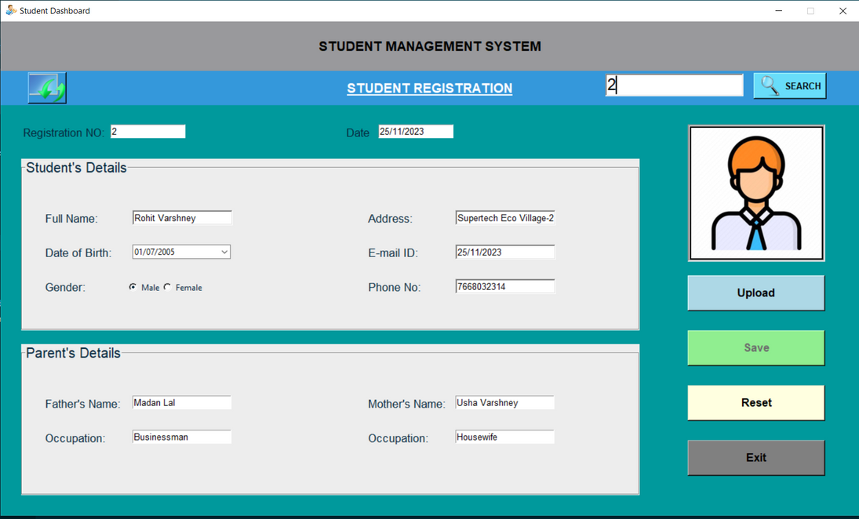
GUI PROGRAMMING IN
PYTHON
REGISTRATION WINDOW

Slide 17
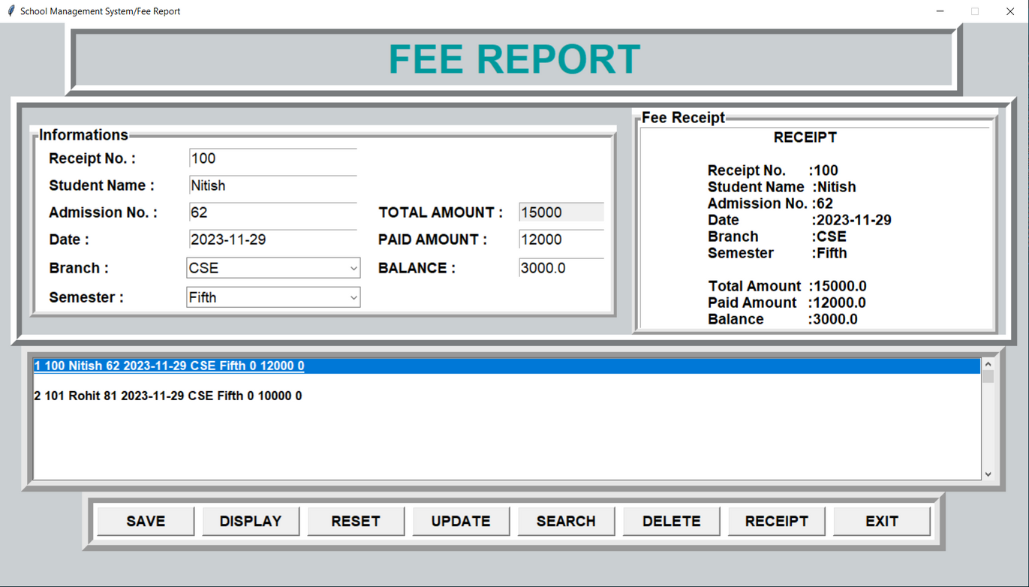
GUI PROGRAMMING IN
PYTHON
ACCOUNT WINDOW

Slide 18
“Student Management System” software developed for an institute has been designed to achieve maximum efficiency and reduce the time taken to handle the storing activity. It is designed to replace an existing manual record system thereby reducing time taken for calculations and for storing data.
CONCLUSION

Slide 19
REFERENCES
BOOKS.
1) PYTHON GUI PROGRAMMING WITH TKINTER - ALAN D MOORE
2) PROGRAMMING WITH PYTHON - BY T R PADMANABHAN
3) COMPUTER SCIENCE WITH PYTHON – BY SUMITA ARORA
4) THE DATABASE BOOK (MYSQL) - BY NARAIN GEHANI
WEBSITES.
1) HTTPS://WWW.GOOGLE.CO.IN
2) HTTPS://WWW.JAVATPOINT.COM
3) HTTPS://WWW.W3SCHOOLS.COM
4) HTTPS://WWW.GEEKSFORGEEKS.ORG

Slide 20


Slide 21


